Slide 1
Regression and Classification with
Neural Networks
Copyright © 2001, 2003, Andrew W. Moore
Sep 25th, 2001

Slide 2
Linear Regression
DATASET
inputs | outputs
x₁ = 1 | y₁ = 1
x₂ = 3 | y₂ = 2.2
x₃ = 2 | y₃ = 2
x₄ = 1.5 | y₄ = 1.9
x₅ = 4 | y₅ = 3.1
↑
w
↓
← 1 →
Linear regression assumes that the expected value of the output given an input, E[y|x], is linear.
Simplest case: Out(x) = wx for some unknown w.
Given the data, we can estimate w.
Copyright © 2001, 2003, Andrew W. Moore

Slide 3
1-parameter linear regression
Assume that the data is formed by
y_{i} = wx_{i} + noise_{i}
where…
the noise signals are independent
the noise has a normal distribution with mean 0 and unknown variance σ²
P(y|w,x) has a normal distribution with
mean wx
variance σ²
Copyright © 2001, 2003, Andrew W. Moore

Slide 4
Bayesian Linear Regression
P(y|w,x) = Normal (mean wx, var σ²)
We have a set of datapoints (x₁,y₁) (x₂,y₂) … (x_{n},y_{n}) which are EVIDENCE about w.
We want to infer w from the data.
P(w|x₁, x₂, x₃,…x_{n}, y₁, y₂…y_{n})
You can use BAYES rule to work out a posterior distribution for w given the data.
Or you could do Maximum Likelihood Estimation
Copyright © 2001, 2003, Andrew W. Moore

Slide 5
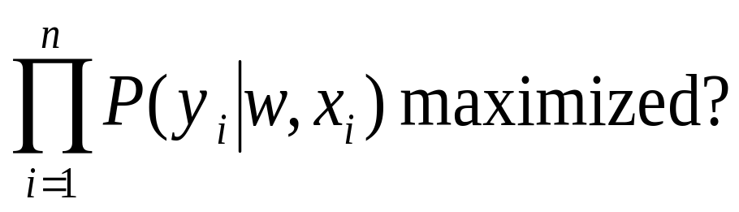
Maximum likelihood estimation of w
Asks the question:
“For which value of w is this data most likely to have happened?”
<=>
For what w is
P(y₁, y₂…y_{n} |x₁, x₂, x₃,…x_{n}, w) maximized?
<=>
For what w is
Copyright © 2001, 2003, Andrew W. Moore

Slide 6
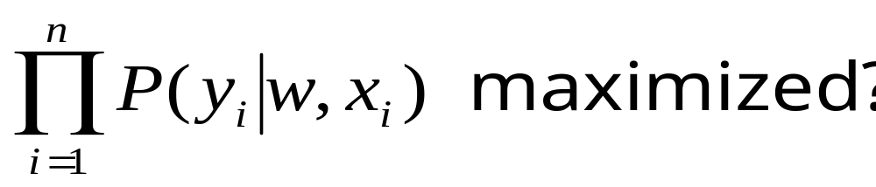
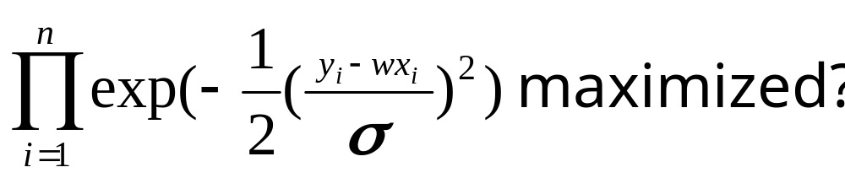
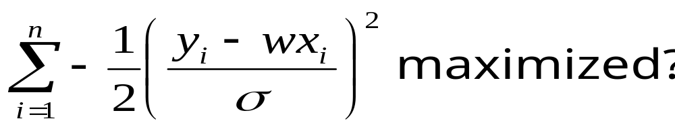
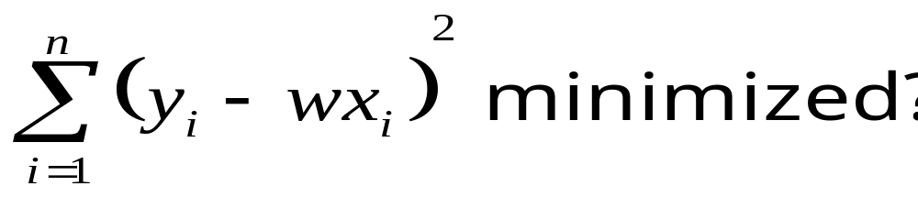
For what w is
For what w is
For what w is
For what w is
Copyright © 2001, 2003, Andrew W. Moore

Slide 7
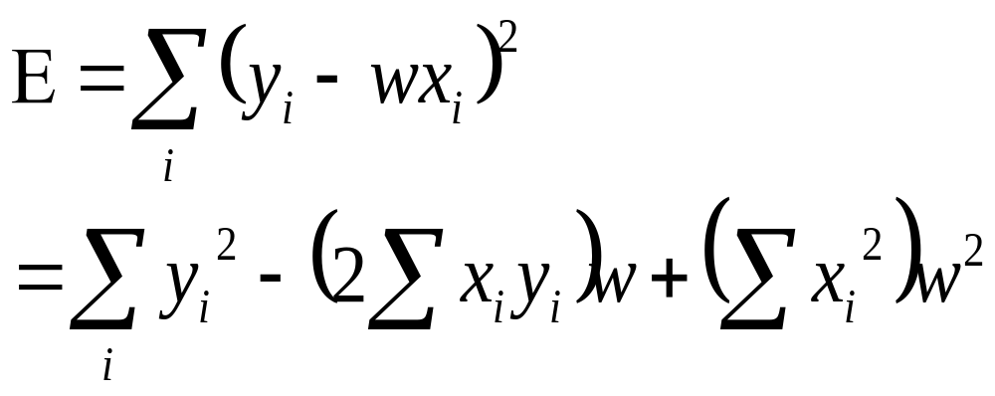
Linear Regression
The maximum likelihood w is the one that minimizes sum-of-squares of residuals
E(w)
w
We want to minimize a quadratic function of w.
Copyright © 2001, 2003, Andrew W. Moore

Slide 8
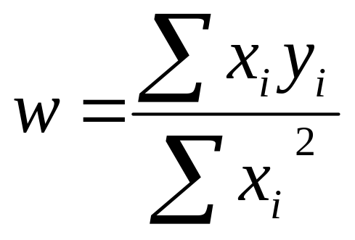
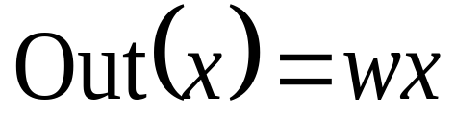
Linear Regression
Easy to show the sum of squares is minimized when
The maximum likelihood model is
We can use it for prediction
Copyright © 2001, 2003, Andrew W. Moore

Slide 9
Linear Regression
Easy to show the sum of squares is minimized when
p(w)
w
Note: In Bayesian stats you’d have ended up with a prob dist of w
And predictions would have given a prob dist of expected output
Often useful to know your confidence. Max likelihood can give some kinds of confidence too.
The maximum likelihood model is
We can use it for prediction
Copyright © 2001, 2003, Andrew W. Moore

Slide 10
Multivariate Regression
What if the inputs are vectors?
3 .
. 4 6 .
. 5
. 8
. 10
2-d input example
x₂
x₁
Dataset has form
x₁ y₁
x₂ y₂
x₃ y₃
.: :
.
x_{R} y_{R}
Copyright © 2001, 2003, Andrew W. Moore

Slide 11
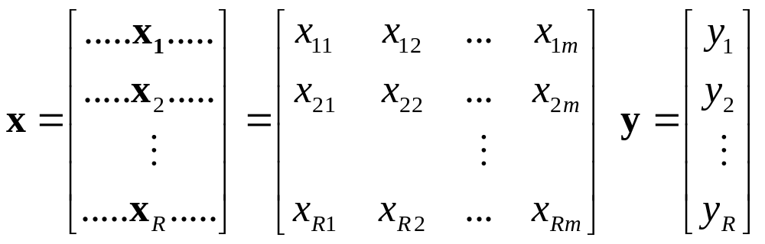
Multivariate Regression
Write matrix X and Y thus:
(there are R datapoints. Each input has m components)
The linear regression model assumes a vector w such that
Out(x) = w^{T}x = w₁x[1] + w₂x[2] + ….w_{m}x[D]
The max. likelihood w is w = (X^{T}X) ⁻¹(X^{T}Y)
Copyright © 2001, 2003, Andrew W. Moore

Slide 12
Multivariate Regression
Write matrix X and Y thus:
IMPORTANT EXERCISE: PROVE IT !!!!!
(there are R datapoints. Each input has m components)
The linear regression model assumes a vector w such that
Out(x) = w^{T}x = w₁x[1] + w₂x[2] + ….w_{m}x[D]
The max. likelihood w is w = (X^{T}X) ⁻¹(X^{T}Y)
Copyright © 2001, 2003, Andrew W. Moore

Slide 13
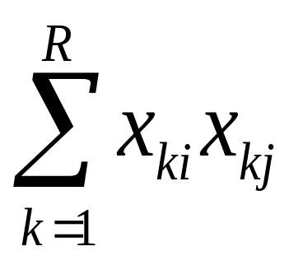
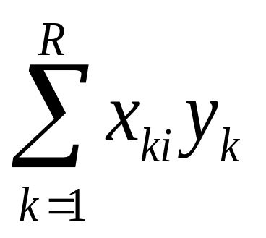
Multivariate Regression (con’t)
The max. likelihood w is w = (X^{T}X)⁻¹(X^{T}Y)
X^{T}X is an m x m matrix: i,j’th elt is
X^{T}Y is an m-element vector: i^{’th} elt
Copyright © 2001, 2003, Andrew W. Moore

Slide 14
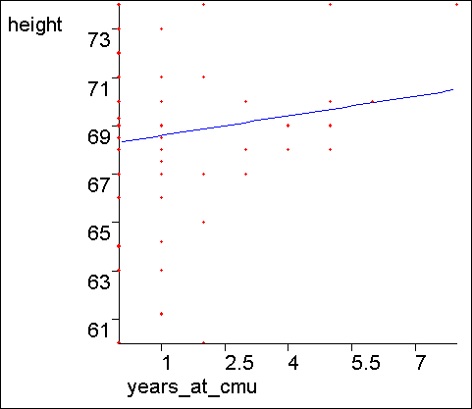
What about a constant term?
We may expect linear data that does not go through the origin.
Statisticians and Neural Net Folks all agree on a simple obvious hack.
Can you guess??
Copyright © 2001, 2003, Andrew W. Moore

Slide 15
The constant term
The trick is to create a fake input “X₀” that always takes the value 1
X₁ | X₂ | Y
2 | 4 | 16
3 | 4 | 17
5 | 5 | 20
X₀ | X₁ | X₂ | Y
1 | 2 | 4 | 16
1 | 3 | 4 | 17
1 | 5 | 5 | 20
Before:
Y=w₁X₁+ w₂X₂
…has to be a poor model
After:
Y= w₀X₀+w₁X₁+ w₂X₂
= w₀+w₁X₁+ w₂X₂
…has a fine constant term
In this example, You should be able to see the MLE w₀ , w₁ and w₂ by inspection
Copyright © 2001, 2003, Andrew W. Moore

Slide 16
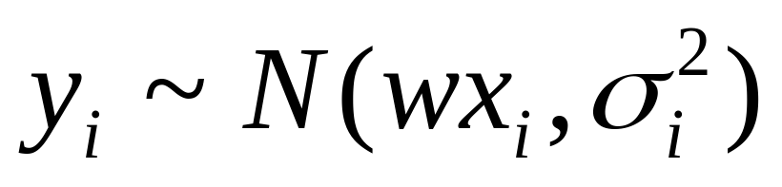
Regression with varying noise
Suppose you know the variance of the noise that was added to each datapoint.
y=3
x_{i} | y_{i} | σ_{i}²
½ | ½ | 4
1 | 1 | 1
2 | 1 | 1/4
2 | 3 | 4
3 | 2 | 1/4
σ=2
y=2
σ=1/2
y=1
σ=1
σ=1/2
σ=2
y=0
x=0
x=1
x=2
x=3
What’s the MLE estimate of w?
Assume
Copyright © 2001, 2003, Andrew W. Moore

Slide 17
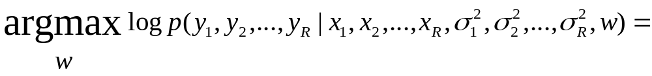
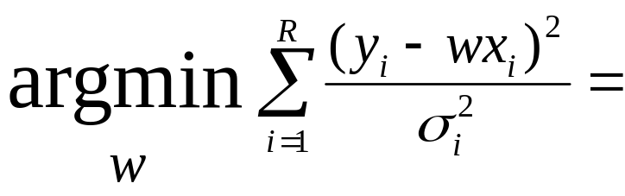
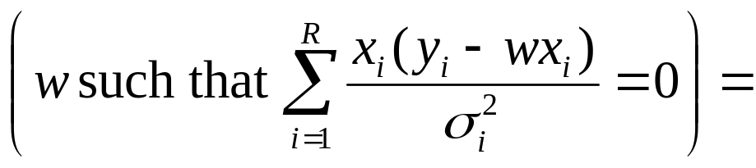
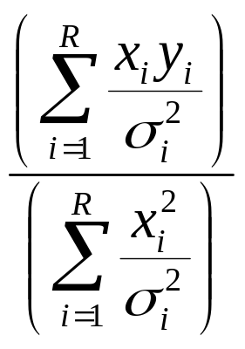
MLE estimation with varying noise
Assuming i.i.d. and then plugging in equation for Gaussian and simplifying.
Setting dLL/dw equal to zero
Trivial algebra
Copyright © 2001, 2003, Andrew W. Moore

Slide 18
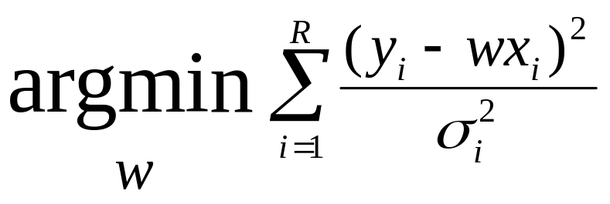
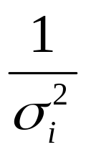
This is Weighted Regression
We are asking to minimize the weighted sum of squares
y=3
σ=2
y=2
σ=1/2
y=1
σ=1
σ=1/2
σ=2
y=0
x=0
x=1
x=2
x=3
where weight for i’th datapoint is
Copyright © 2001, 2003, Andrew W. Moore

Slide 19
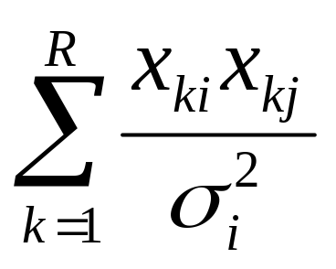
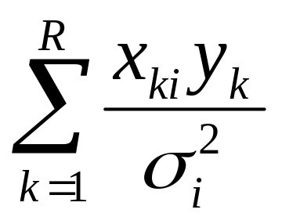
Weighted Multivariate Regression
The max. likelihood w is w = (WX^{T}WX)⁻¹(WX^{T}WY)
(WX^{T}WX) is an m x m matrix: i,j’th elt is
(WX^{T}WY) is an m-element vector: i^{’th} elt
Copyright © 2001, 2003, Andrew W. Moore

Slide 20
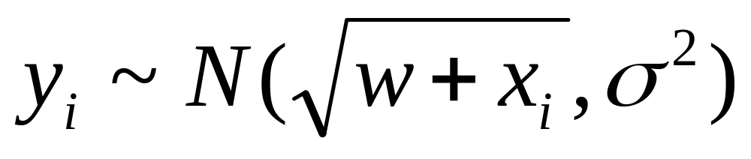
Non-linear Regression
Suppose you know that y is related to a function of x in such a way that the predicted values have a non-linear dependence on w, e.g:
y=3
x_{i} | y_{i}
½ | ½
1 | 2.5
2 | 3
3 | 2
3 | 3
y=2
y=1
y=0
x=0
x=1
x=2
x=3
What’s the MLE estimate of w?
Assume
Copyright © 2001, 2003, Andrew W. Moore

Slide 21
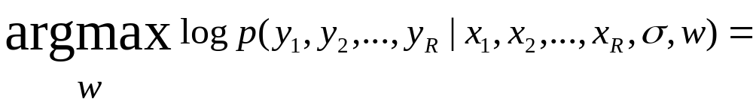
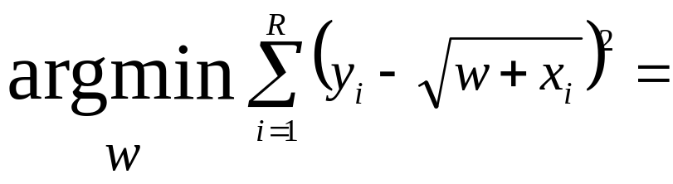
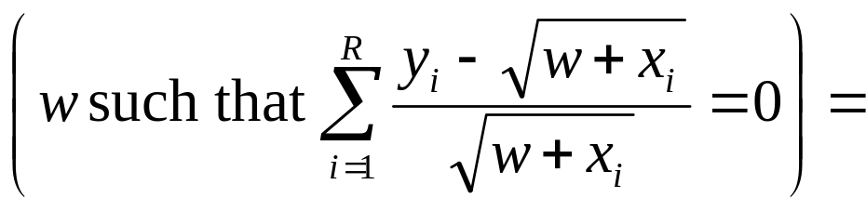
Non-linear MLE estimation
Assuming i.i.d. and then plugging in equation for Gaussian and simplifying.
Setting dLL/dw equal to zero
Copyright © 2001, 2003, Andrew W. Moore

Slide 22
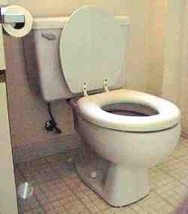
Non-linear MLE estimation
Assuming i.i.d. and then plugging in equation for Gaussian and simplifying.
Setting dLL/dw equal to zero
We’re down the algebraic toilet
So guess what we do?
Copyright © 2001, 2003, Andrew W. Moore

Slide 23
Non-linear MLE estimation
Assuming i.i.d. and then plugging in equation for Gaussian and simplifying.
Common (but not only) approach:
Numerical Solutions:
Line Search
Simulated Annealing
Gradient Descent
Conjugate Gradient
Levenberg Marquart
Newton’s Method
Setting dLL/dw equal to zero
We’re down the algebraic toilet
Also, special purpose statistical-optimization-specific tricks such as E.M. (See Gaussian Mixtures lecture for introduction)
So guess what we do?
Copyright © 2001, 2003, Andrew W. Moore

Slide 24
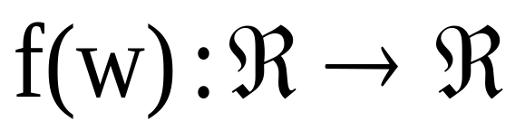
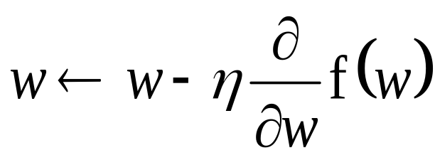
GRADIENT DESCENT
Suppose we have a scalar function
We want to find a local minimum.
Assume our current weight is w
GRADIENT DESCENT RULE:
η is called the LEARNING RATE. A small positive number, e.g. η = 0.05
Copyright © 2001, 2003, Andrew W. Moore

Slide 25
GRADIENT DESCENT
Suppose we have a scalar function
We want to find a local minimum.
Assume our current weight is w
GRADIENT DESCENT RULE:
η is called the LEARNING RATE. A small positive number, e.g. η = 0.05
Recall Andrew’s favorite default value for anything
QUESTION: Justify the Gradient Descent Rule
Copyright © 2001, 2003, Andrew W. Moore

Slide 26
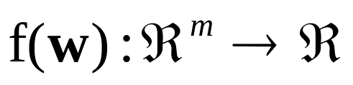
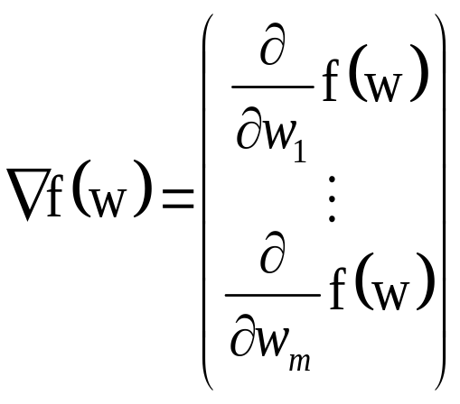
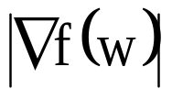
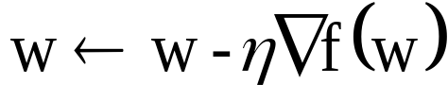
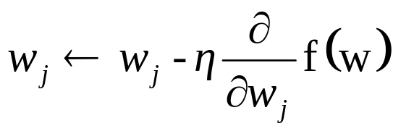
Gradient Descent in “m” Dimensions
Given
points in direction of steepest ascent.
is the gradient in that direction
GRADIENT DESCENT RULE:
Equivalently
….where w_{j} is the jth weight
“just like a linear feedback system”
Copyright © 2001, 2003, Andrew W. Moore

Slide 27
What’s all this got to do with Neural Nets, then, eh??
For supervised learning, neural nets are also models with vectors of w parameters in them. They are now called weights.
As before, we want to compute the weights to minimize sum-of-squared residuals.
        Which turns out, under “Gaussian i.i.d noise”
        assumption to be max. likelihood.
Instead of explicitly solving for max. likelihood weights, we use GRADIENT DESCENT to SEARCH for them.
“Why?” you ask, a querulous expression in your eyes.
“Aha!!” I reply: “We’ll see later.”
Copyright © 2001, 2003, Andrew W. Moore

Slide 28
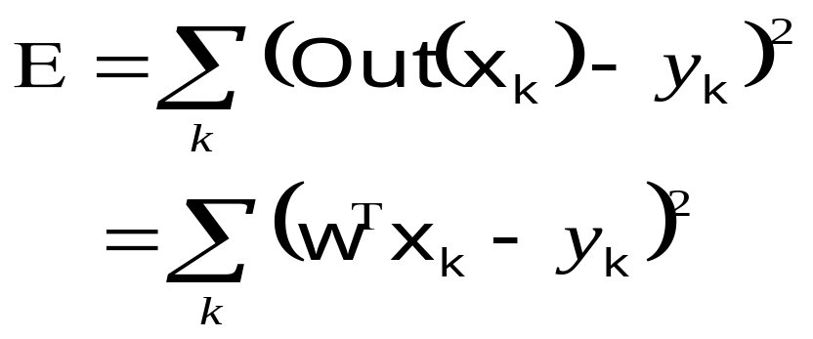
Linear Perceptrons
They are multivariate linear models:
Out(x) = w^{T}x
And “training” consists of minimizing sum-of-squared residuals by gradient descent.
QUESTION: Derive the perceptron training rule.
Copyright © 2001, 2003, Andrew W. Moore

Slide 29
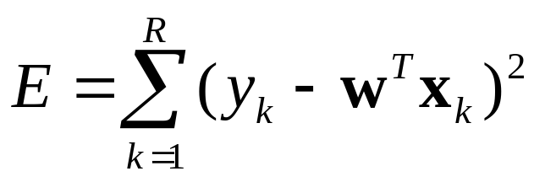
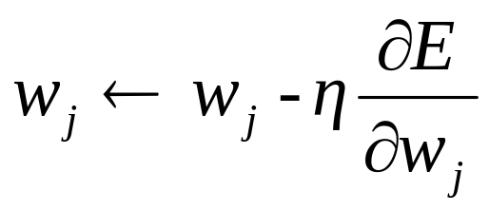
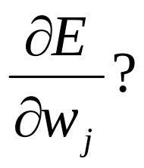
Linear Perceptron Training Rule
Gradient descent tells us we should update w thusly if we wish to minimize E:
So what’s
Copyright © 2001, 2003, Andrew W. Moore

Slide 30
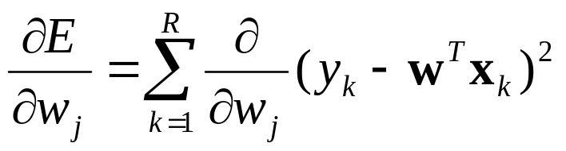
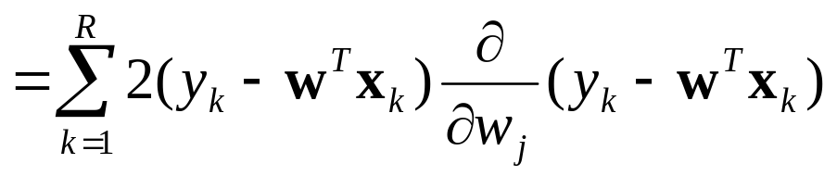
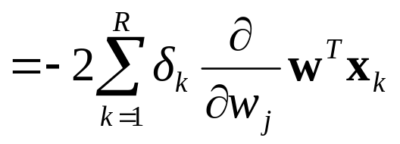
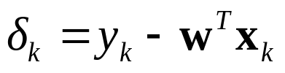
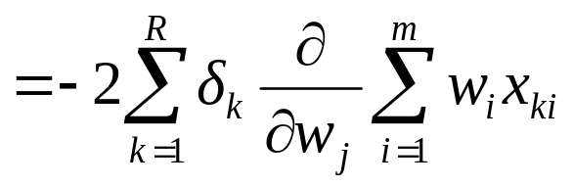
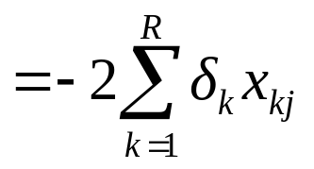
Linear Perceptron Training Rule
Gradient descent tells us we should update w thusly if we wish to minimize E:
…where…
So what’s
Copyright © 2001, 2003, Andrew W. Moore

Slide 31
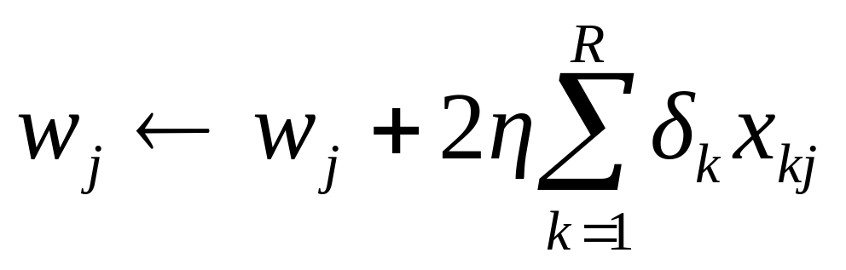
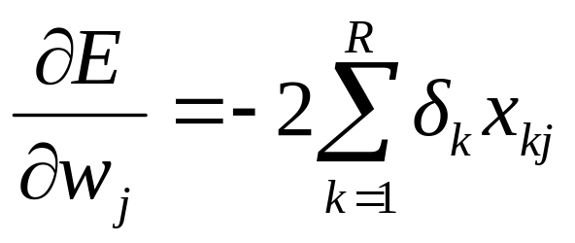
Linear Perceptron Training Rule
Gradient descent tells us we should update w thusly if we wish to minimize E:
…where…
We frequently neglect the 2 (meaning we halve the learning rate)
Copyright © 2001, 2003, Andrew W. Moore

Slide 32
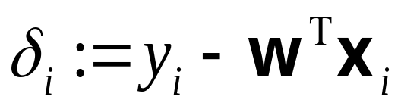
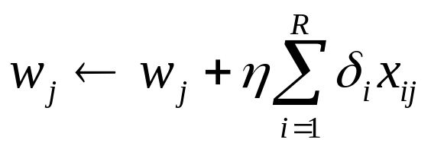
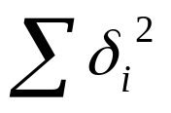
The “Batch” perceptron algorithm
Randomly initialize weights w₁ w₂ … w_{m}
Get your dataset (append 1’s to the inputs if you don’t want to go through the origin).
for i = 1 to R
for j = 1 to m
if stops improving then stop. Else loop back to 3.
Copyright © 2001, 2003, Andrew W. Moore

Slide 33
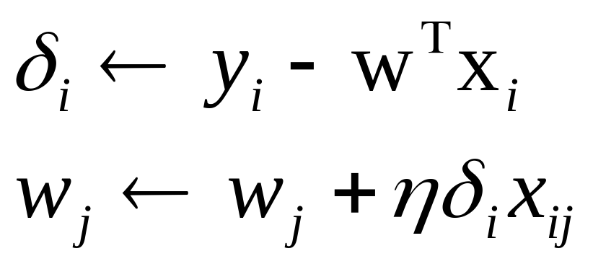
A RULE KNOWN BY
MANY NAMES
The Widrow Hoff rule
The LMS Rule
The delta rule
The adaline rule
Classical
conditioning
Copyright © 2001, 2003, Andrew W. Moore

Slide 34
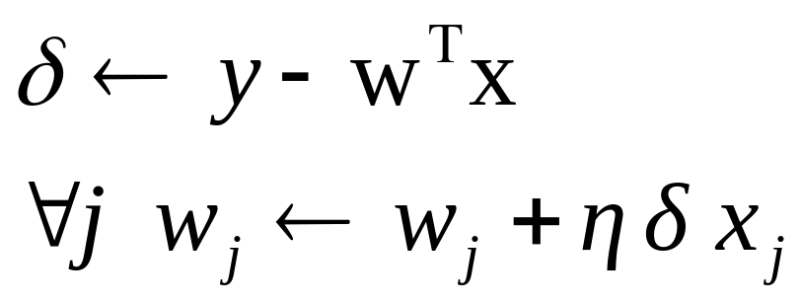
If data is voluminous and arrives fast
Input-output pairs (x,y) come streaming in very quickly. THEN
Don’t bother remembering old ones. Just keep using new ones.
observe (x,y)
Copyright © 2001, 2003, Andrew W. Moore

Slide 35
Gradient Descent vs Matrix Inversion for Linear Perceptrons
GD Advantages (MI disadvantages):
Biologically plausible
With very very many attributes each iteration costs only O(mR). If fewer than m iterations needed we’ve beaten Matrix Inversion
More easily parallelizable (or implementable in wetware)?
GD Disadvantages (MI advantages):
It’s moronic
It’s essentially a slow implementation of a way to build the XTX matrix and then solve a set of linear equations
If m is small it’s especially outageous. If m is large then the direct matrix inversion method gets fiddly but not impossible if you want to be efficient.
Hard to choose a good learning rate
Matrix inversion takes predictable time. You can’t be sure when gradient descent will stop.
Copyright © 2001, 2003, Andrew W. Moore

Slide 36
Gradient Descent vs Matrix Inversion for Linear Perceptrons
GD Advantages (MI disadvantages):
Biologically plausible
With very very many attributes each iteration costs only O(mR). If fewer than m iterations needed we’ve beaten Matrix Inversion
More easily parallelizable (or implementable in wetware)?
GD Disadvantages (MI advantages):
It’s moronic
It’s essentially a slow implementation of a way to build the XTX matrix and then solve a set of linear equations
If m is small it’s especially outageous. If m is large then the direct matrix inversion method gets fiddly but not impossible if you want to be efficient.
Hard to choose a good learning rate
Matrix inversion takes predictable time. You can’t be sure when gradient descent will stop.
Copyright © 2001, 2003, Andrew W. Moore

Slide 37
Gradient Descent vs Matrix Inversion for Linear Perceptrons
But we’ll
soon see that
GD
has an important extra
trick up its sleeve
GD Advantages (MI disadvantages):
Biologically plausible
With very very many attributes each iteration costs only O(mR). If fewer than m iterations needed we’ve beaten Matrix Inversion
More easily parallelizable (or implementable in wetware)?
GD Disadvantages (MI advantages):
It’s moronic
It’s essentially a slow implementation of a way to build the XTX matrix and then solve a set of linear equations
If m is small it’s especially outageous. If m is large then the direct matrix inversion method gets fiddly but not impossible if you want to be efficient.
Hard to choose a good learning rate
Matrix inversion takes predictable time. You can’t be sure when gradient descent will stop.
Copyright © 2001, 2003, Andrew W. Moore

Slide 38
Perceptrons for Classification
What if all outputs are 0’s or 1’s ?
or
We can do a linear fit.
Our prediction is 0 if out(x)≤1/2
1 if out(x)>1/2
WHAT’S THE BIG PROBLEM WITH THIS???
Copyright © 2001, 2003, Andrew W. Moore

Slide 39
Perceptrons for Classification
What if all outputs are 0’s or 1’s ?
or
Blue = Out(x)
We can do a linear fit.
Our prediction is 0 if out(x)≤½
1 if out(x)>½
WHAT’S THE BIG PROBLEM WITH THIS???
Copyright © 2001, 2003, Andrew W. Moore

Slide 40
Perceptrons for Classification
What if all outputs are 0’s or 1’s ?
or
Blue = Out(x)
We can do a linear fit.
Our prediction is 0 if out(x)≤½
1 if out(x)>½
Green = Classification
Copyright © 2001, 2003, Andrew W. Moore

Slide 41


Classification with Perceptrons I
Don’t minimize
Minimize number of misclassifications instead. [Assume outputs are +1 & -1, not +1 & 0]
NOTE: CUTE &
NON OBVIOUS WHY
THIS WORKS!!
where Round(x) = -1 if x<0
1 if x≥0
The gradient descent rule can be changed to:
if (x_{i},y_{i}) correctly classed, don’t change
if wrongly predicted as 1 w ← w - x_{i}
if wrongly predicted as -1 w ← w + x_{i}
Copyright © 2001, 2003, Andrew W. Moore

Slide 42
Classification with Perceptrons II:
Sigmoid Functions
Least squares fit useless
This fit would classify much better. But not a least squares fit.
Copyright © 2001, 2003, Andrew W. Moore

Slide 43

Classification with Perceptrons II:
Sigmoid Functions
Least squares fit useless
This fit would classify much better. But not a least squares fit.
SOLUTION:
Instead of Out(x) = w^{T}x
We’ll use Out(x) = g(w^{T}x)
where is a squashing function
Copyright © 2001, 2003, Andrew W. Moore

Slide 44


The Sigmoid
Note that if you rotate this curve through 180º centered on (0,1/2) you get the same curve.
i.e. g(h)=1-g(-h)
Can you prove this?
Copyright © 2001, 2003, Andrew W. Moore

Slide 45

The Sigmoid
Now we choose w to minimize
Copyright © 2001, 2003, Andrew W. Moore

Slide 46
Linear Perceptron Classification Regions
0 0
0
1
1
1
X₂
X₁
We’ll use the model Out(x) = g(w^{T}(x,1))
= g(w₁x₁ + w₂x₂ + w₀)
Which region of above diagram classified with +1, and which with 0 ??
Copyright © 2001, 2003, Andrew W. Moore

Slide 47




Gradient descent with sigmoid on a perceptron
The sigmoid perceptron update rule:
where
Copyright © 2001, 2003, Andrew W. Moore

Slide 48
Other Things about Perceptrons
Invented and popularized by Rosenblatt (1962)
Even with sigmoid nonlinearity, correct convergence is guaranteed
Stable behavior for overconstrained and underconstrained problems
Copyright © 2001, 2003, Andrew W. Moore

Slide 49
Perceptrons and Boolean Functions
If inputs are all 0’s and 1’s and outputs are all 0’s and 1’s…
Can learn the function x₁ ∧ x₂
Can learn the function x₁ ∨ x₂ .
Can learn any conjunction of literals, e.g.
x₁ ∧ ~x₂ ∧ ~x₃ ∧ x₄ ∧ x₅
QUESTION: WHY?
X₂
X₁
X₂
X₁
Copyright © 2001, 2003, Andrew W. Moore

Slide 50
Perceptrons and Boolean Functions
Can learn any disjunction of literals
e.g. x₁ ∧ ~x₂ ∧ ~x₃ ∧ x₄ ∧ x₅
Can learn majority function
f(x₁,x₂ … x_{n}) = 1 if n/2 x_{i}’s or more are = 1
0 if less than n/2 x_{i}’s are = 1
What about the exclusive or function?
f(x₁,x₂) = x₁ ∀ x₂ =
(x₁ ∧ ~x₂) ∨ (~ x₁ ∧ x₂)
Copyright © 2001, 2003, Andrew W. Moore

Slide 51


Multilayer Networks
The class of functions representable by perceptrons is limited
Use a wider representation !
This is a nonlinear function
Of a linear combination
Of non linear functions
Of linear combinations of inputs
Copyright © 2001, 2003, Andrew W. Moore

Slide 52


A 1-HIDDEN LAYER NET
N_{INPUTS} = 2 N_{HIDDEN} = 3
w₁₁
x₁
w₁
w₂₁
w₃₁
w₂
w₁₂
x₂
w₂₂
w₃
w₃₂
Copyright © 2001, 2003, Andrew W. Moore

Slide 53

OTHER NEURAL NETS
1
x₁
x₂
x₃
2-Hidden layers + Constant Term
“JUMP” CONNECTIONS
x₁
x₂
Copyright © 2001, 2003, Andrew W. Moore

Slide 54

Backpropagation
That’s it!
That’s the backpropagation algorithm.
Copyright © 2001, 2003, Andrew W. Moore

Slide 55
Backpropagation Convergence
Convergence to a global minimum is not guaranteed.
In practice, this is not a problem, apparently.
Tweaking to find the right number of hidden units, or a useful learning rate η, is more hassle, apparently.
IMPLEMENTING BACKPROP:  Differentiate Monster sum-square residual  Write down the Gradient Descent Rule  It turns out to be easier & computationally efficient to use lots of local variables with names like h_{j} o_{k} v_{j} net_{i} etc…
Copyright © 2001, 2003, Andrew W. Moore

Slide 56
Choosing the learning rate
This is a subtle art.
Too small: can take days instead of minutes to converge
Too large: diverges (MSE gets larger and larger while the weights increase and usually oscillate)
Sometimes the “just right” value is hard to find.
Copyright © 2001, 2003, Andrew W. Moore

Slide 57

Learning-rate problems
From J. Hertz, A. Krogh, and R. G. Palmer. Introduction to the Theory of Neural Computation. Addison-Wesley, 1994.
Copyright © 2001, 2003, Andrew W. Moore

Slide 58



Improving Simple Gradient Descent
Momentum
Don’t just change weights according to the current datapoint.
Re-use changes from earlier iterations.
Let ∆w(t) = weight changes at time t.
Let be the change we would make with
regular gradient descent.
Instead we use
Momentum damps oscillations.
A hack? Well, maybe.
momentum parameter
Copyright © 2001, 2003, Andrew W. Moore

Slide 59

Momentum illustration
Copyright © 2001, 2003, Andrew W. Moore

Slide 60

Improving Simple Gradient Descent
Newton’s method
If we neglect the O(h³) terms, this is a quadratic form
Quadratic form fun facts:
If y = c + b^{T} x - 1/2 x^{T} A x
And if A is SPD
Then
x^{opt} = A⁻¹b is the value of x that maximizes y
Copyright © 2001, 2003, Andrew W. Moore

Slide 61

Improving Simple Gradient Descent
Newton’s method
If we neglect the O(h³) terms, this is a quadratic form
This should send us directly to the global minimum if the function is truly quadratic.
And it might get us close if it’s locally quadraticish
Copyright © 2001, 2003, Andrew W. Moore

Slide 62
Improving Simple Gradient Descent
Newton’s method
If we neglect the O(h³) terms, this is a quadratic form
BUT (and it’s a big but)…
That second derivative matrix can be expensive and fiddly to compute.
If we’re not already in the quadratic bowl, we’ll go nuts.
This should send us directly to the global minimum if the function is truly quadratic.
And it might get us close if it’s locally quadraticish
Copyright © 2001, 2003, Andrew W. Moore

Slide 63


Improving Simple Gradient Descent
Conjugate Gradient
Another method which attempts to exploit the “local quadratic bowl” assumption
But does so while only needing to use
and not
It is also more stable than Newton’s method if the local quadratic bowl assumption is violated.
It’s complicated, outside our scope, but it often works well. More details in Numerical Recipes in C.
Copyright © 2001, 2003, Andrew W. Moore

Slide 64
BEST GENERALIZATION
Intuitively, you want to use the smallest, simplest net that seems to fit the data.
HOW TO FORMALIZE THIS INTUITION?
  Don’t. Just use intuition
  Bayesian Methods Get it Right
  Statistical Analysis explains what’s going on
  Cross-validation
Discussed in the next lecture
Copyright © 2001, 2003, Andrew W. Moore

Slide 65
What You Should Know
How to implement multivariate Least-squares linear regression.
Derivation of least squares as max. likelihood estimator of linear coefficients
The general gradient descent rule
Copyright © 2001, 2003, Andrew W. Moore

Slide 66
What You Should Know
Perceptrons
→ Linear output, least squares
→ Sigmoid output, least squares
Multilayer nets
→ The idea behind back prop
→ Awareness of better minimization methods
Generalization. What it means.
Copyright © 2001, 2003, Andrew W. Moore

Slide 67
APPLICATIONS
To Discuss:
  What can non-linear regression be useful for?
  What can neural nets (used as non-linear regressors) be useful for?
  What are the advantages of N. Nets for nonlinear regression?
  What are the disadvantages?
Copyright © 2001, 2003, Andrew W. Moore

Slide 68
Other Uses of Neural Nets…
Time series with recurrent nets
Unsupervised learning (clustering principal components and non-linear versions thereof)
Combinatorial optimization with Hopfield nets, Boltzmann Machines
Evaluation function learning (in reinforcement learning)
Copyright © 2001, 2003, Andrew W. Moore

